Slide 1



My Experience
Hacking Video Games
Notes:
Test

Slide 2

Penetration Tester at GoSecure
Hackfest Challenge Designer
Video Game Hacker
Vulnhub VM Creator
Hardcore Path Of Exile Player
Linux Fan
Synack Red Teamer
Crazy Screen Lover
https://twitter.com/ViperBlackSkull

Slide 3
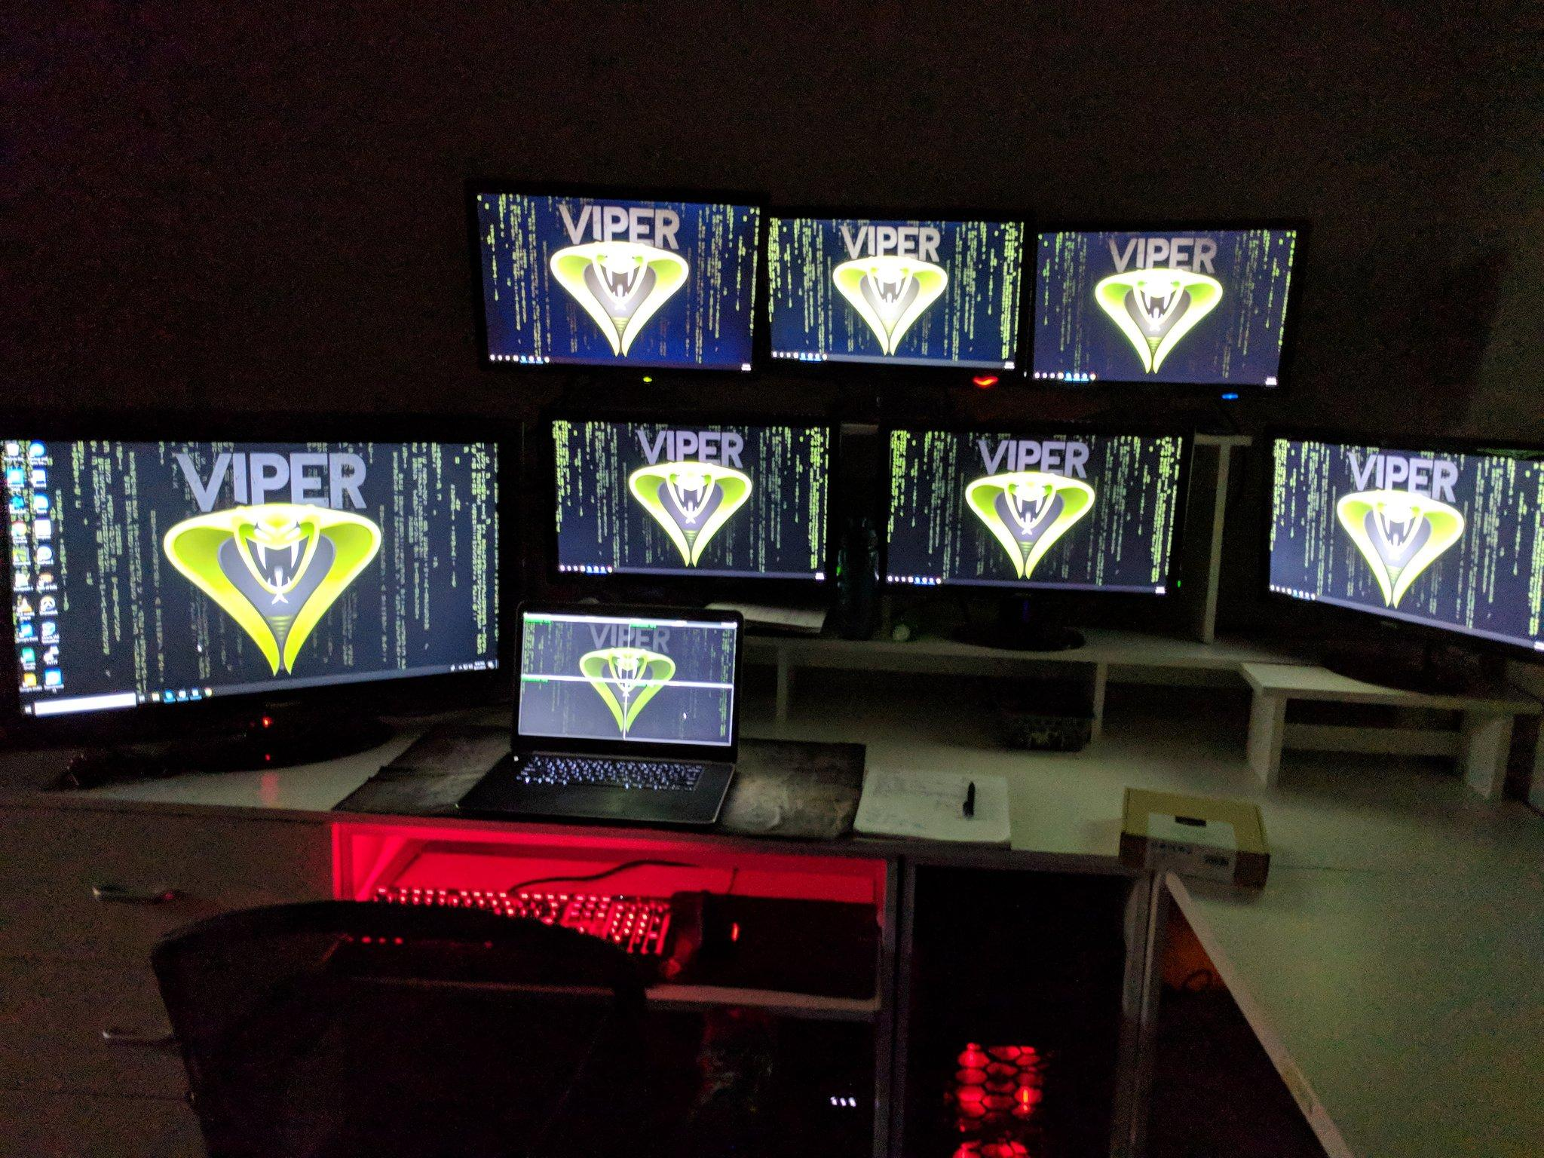

Slide 4
Fun Statistics
Played WoW for 3 years without paying (Selling Gold for payment)
Always Playing 2 WoW accounts simultaneously (Raid + Economy Gambling)
Made money while going to primary school (Bot + eBay)
Highest single item sold was 300$ US
Notes:
Ask question for WoW

Slide 5
Why Game Hacking?
It’s only against the TOS
Economy and economy in video games is a way to emulate it with less consequences
Intellectual challenge
Make money with a computer

Slide 6
Lexicon
Duping = Creating a second copy of the item itself
RMT = Real Money Trading (Converting virtual currency for real money)
Map Hack = Seeing information you shouldn’t be able to see in game
Poof = Item that disappears
RPG = Role Playing Game

Slide 7
Possible Goals
Infinite Experience
Infinite Gold
Dupe Items
Automated Farming / Levelling
Real Money
Win Games
Map Hack
Challenge

Slide 8
Table of Content
Client Side Attacks ( Part 1 )
Server Side Attacks ( Part 2 )
Game Engine Attacks ( Part 2 or 3 )

Slide 9
Client Side Attacks
Memory Manipulation
Task Automation
Ressource Editing
Reverse Engineering
Network Reverse Engineering
Dll Injection
Camera Hacks

Slide 10

Memory Manipulation
Pros:
Modify any variable within the client
Possibility of creating a trainer
Access to information you normally shouldn’t be able to see

Slide 11
Memory Manipulation
Cons:
Easy to detect
Work rarely on multiplayer games
Tools:
Cheat Engine
Game Guardian

Slide 12
Memory Manipulation
Prevention:
Anti Cheat
Debugging Protection
Server Side Storage
Detect known ‘bad’ process running
Possible Hacks:
Infinite Money
Read information not normally accessible

Slide 13


Memory Manipulation Example
Tools Used: Memu Play or Nox + Game Guardian
APK : Infinitode
Requirements: Rooted Android Device or Emulator
Note: Money variable editing didn’t work

Slide 14
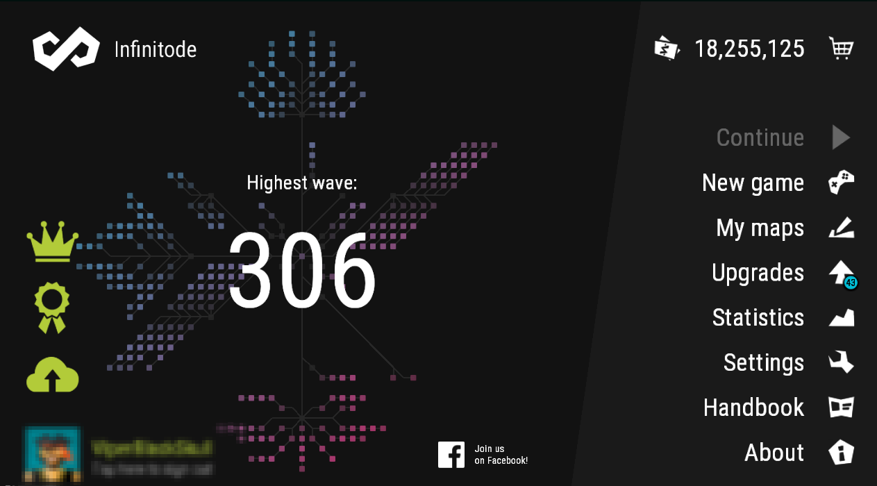
Notes:
CONTEXT:
Talk about the game.
Tell money what you can do with it

Slide 15
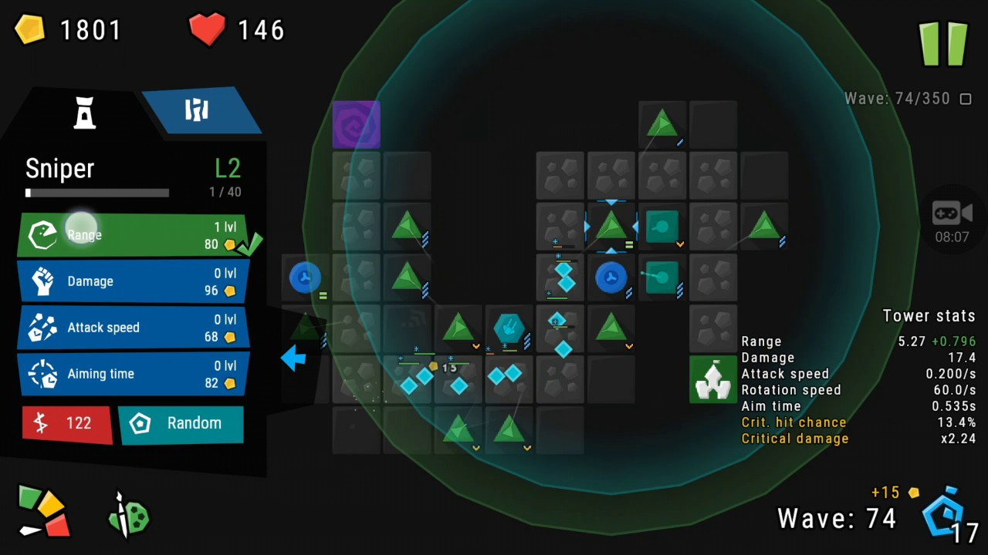
Notes:
CONTEXT:
Talk about the game.
Tell money what you can do with it

Slide 16
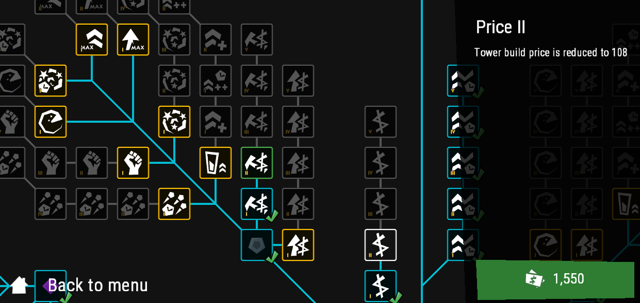

Slide 17
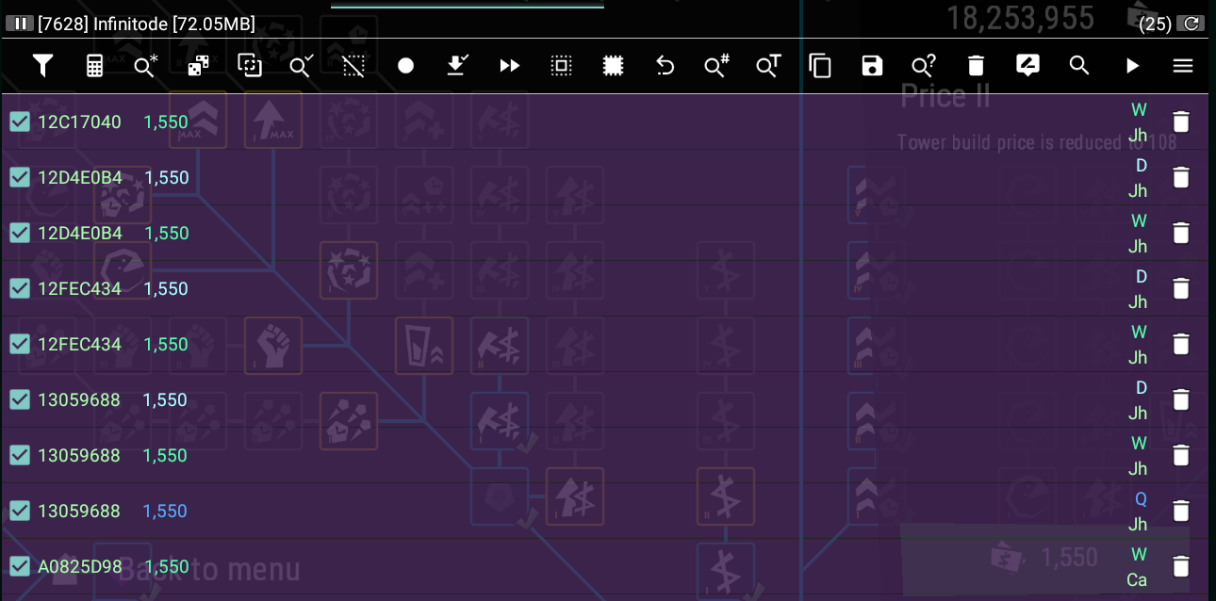

Slide 18
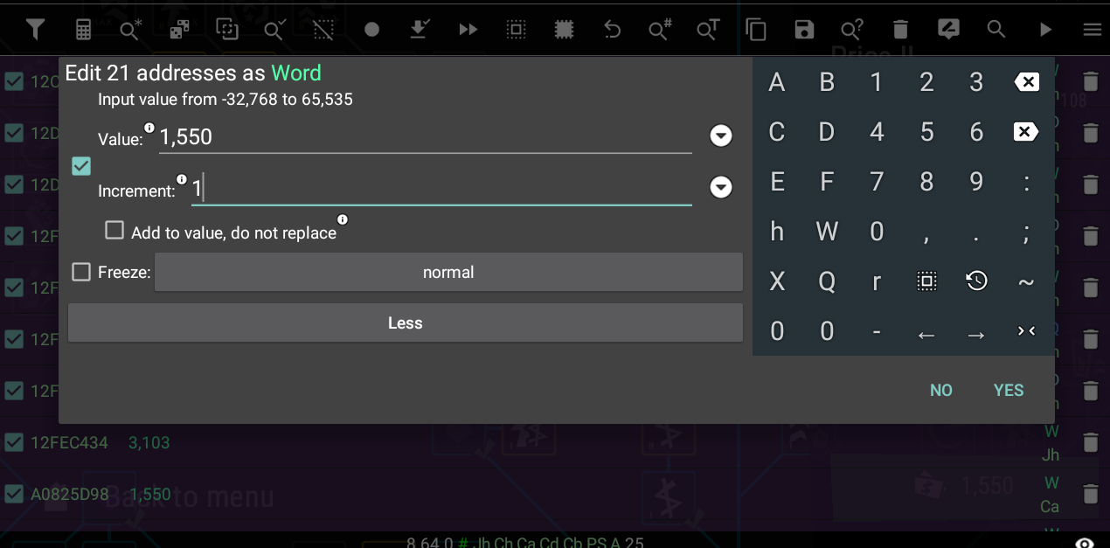

Slide 19
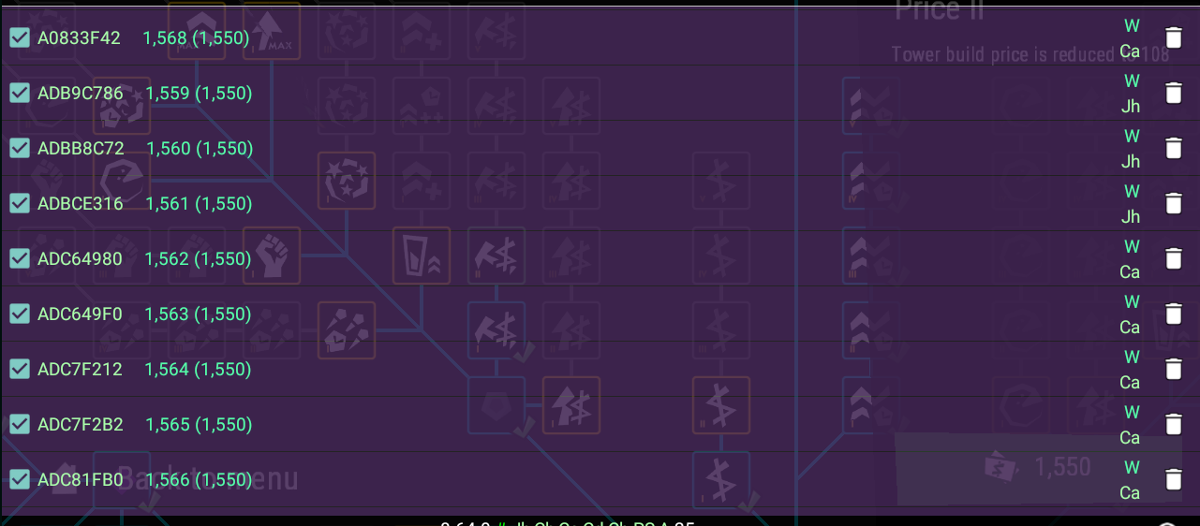

Slide 20
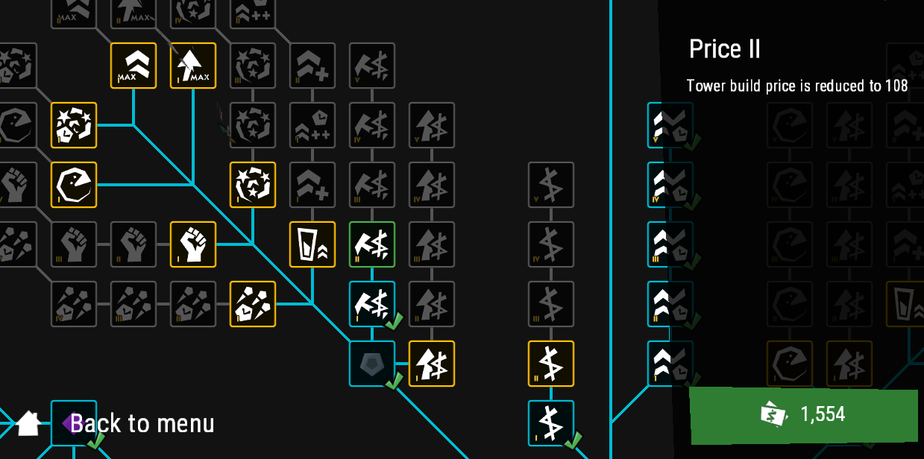

Slide 21
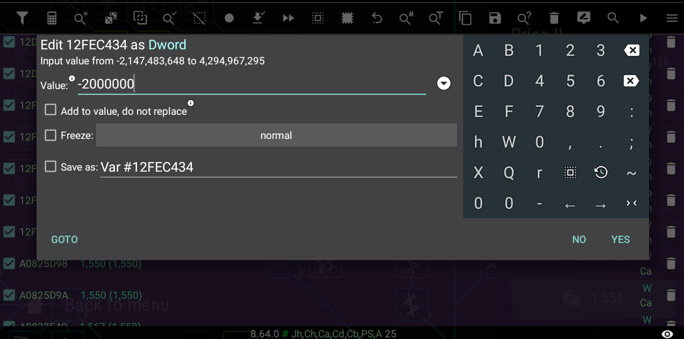

Slide 22
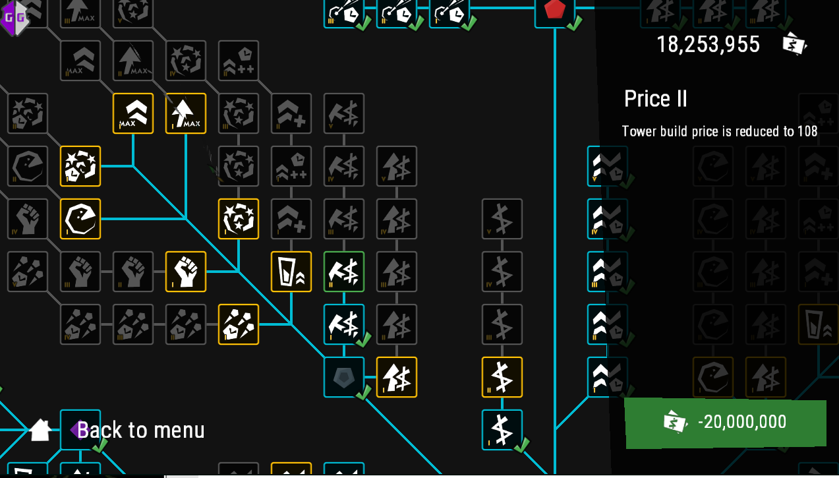

Slide 23
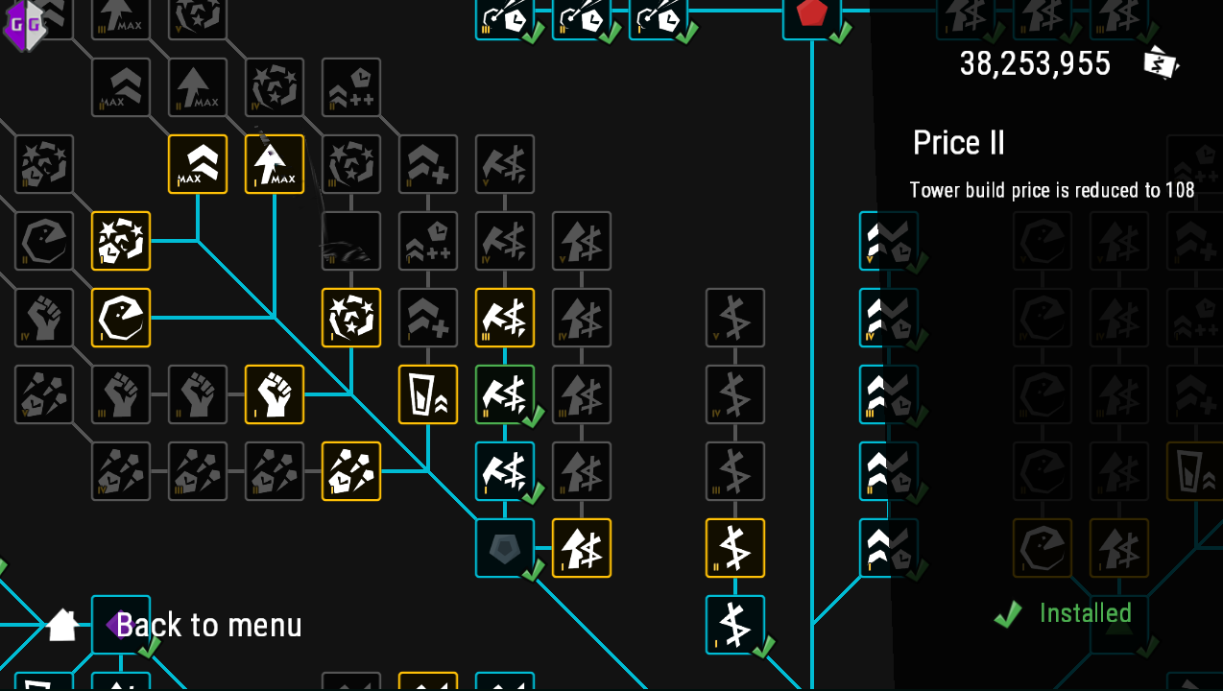

Slide 24
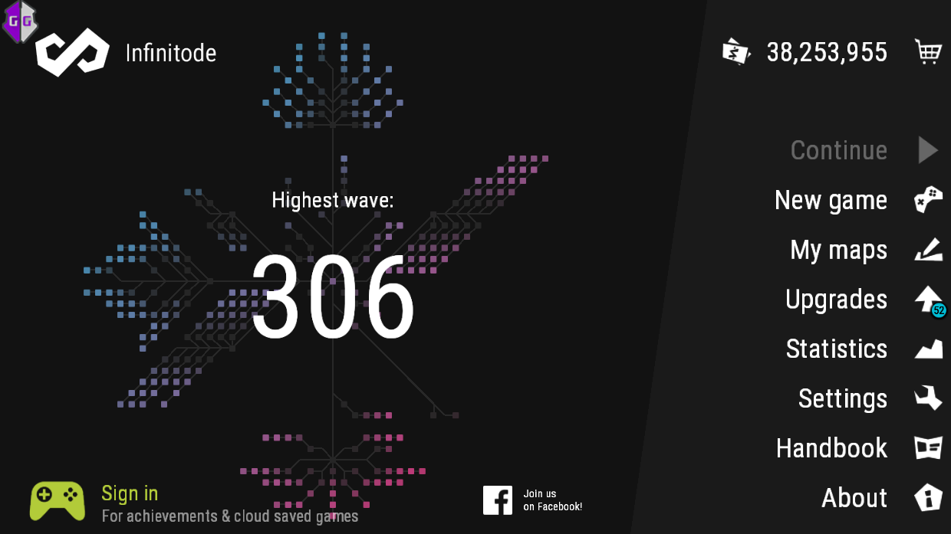

Slide 25


Slide 26

Memory Manipulation in Online Games
Exemple #1: Path Of Exile
POE Racing
ARPG -

Slide 27
Memory Manipulation in Online Games
Gather information in memory that the game client otherwise doesn’t show you.
Advantages:
Seeing enemy before the games show them.
Seeing the entire map before exploring it.
Example : ExileHUD
https://www.youtube.com/watch?v=wd1ForDQ-lw

Slide 28
Memory Manipulation in Online Games
Why?
Advantage over other players
Economic advantage
Level advantage
Ladder Push

Slide 29

Memory Manipulation in Online Games
Gather information in memory that the game client otherwise doesn’t show you.
Context: Warcraft III
Real Time Strategy
Prevention: Pixel and Player Seeing Function

Slide 30
Memory Manipulation in Online Games
Gather information in memory that the game client otherwise doesn’t show you.
Example : Warcraft III - Dota
Map Hack
Run Video
Warcraft III Prevent (Map Hack)

Slide 31
Task Automation
Pros:
Save time!
Run while you do other stuff
Improve accuracy
Speed up
Tools:
AHK - https://autohotkey.com/
AutoClicker
Python

Slide 32
Task Automation
Cons:
Require computer resources
You become lazy in games
Takes control of your mouse (if not in VM)
Prevention:
Anti-Cheat
Behavior Analysis

Slide 33
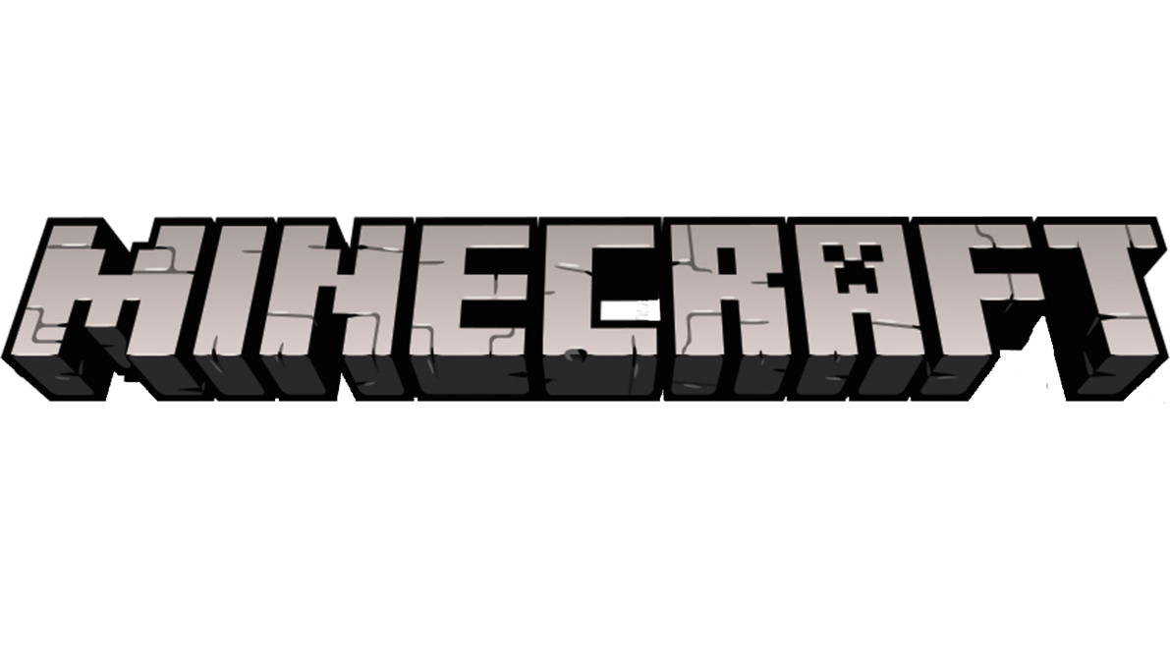
Task Automation
Exemple #1:
Zombie Spawner
Goals:
Infinite loot and experience

Slide 34
Task Automation
Code Example:
Show MCBot code example

Slide 35
Task Automation
Exemple #1:
Run Video

Slide 36

Task Automation
Exemple #2:
Alt Farming
Tools: Mouse Recorder Premium
Goals:
Increase Number of Ressource You have to get stronger in game

Slide 37
Task Automation
Exemple #2:
Run Video

Slide 38

Task Automation
Exemple #3:
TMR Farming
Tools: Nox + Macro
Goals:
Increase number of resource you have to get stronger in game

Slide 39
Task Automation
Exemple #3:
Run Video

Slide 40
Heavy Task Automation
Pros:
Save time!
Run while you do other stuff
Improve accuracy
Speed up
Tools:
Custom Code
C++

Slide 41
Heavy Task Automation
Cons:
Takes time to build
Require good programming skills
Probably multiple people
If game is patched, your bot might no longer work
Always new features to implement
Prevention:
Anti-Cheat
Behavior and Human Analysis

Slide 42
Heavy Task Automation
Features:
Monster searching and killing
Potion taking and chicken
Inventory Stashing
Vendoring
Automatic Game Restart

Slide 43
Heavy Task Automation
Exemple #1: Exiled Bot
Run Video

Slide 44

Heavy Task Automation
Exemple #2:
Run Diablo II Bot Video

Slide 45

Heavy Task Automation
Exemple #3:
SmashBot
https://www.youtube.com/watch?v=6CfPnK76B9A&t=152s
Code: https://github.com/altf4/SmashBot

Slide 46
How to Prevent Bot
Paid company leave the bot knowingly for 3 month + (my experience) because its profitable for them to make the botter rebuy the game.
Anti-Cheat (Check client memory for modification etc.)
Public bots are easier to detect
Separate zone from players (Players see less Bots) - Path Of Exile
Server Logs - Human Staff - Look for anomalies (24h playtime)

Slide 47
Resource Editing - Save Editing
Pros:
Saved variable control
Game optimisation (no more animation)
Visual advantage (player’s head)
Tools:
Text Editor

Slide 48
Resource Editing
Cons:
Can crash game
Require game knowledge
Prevention:
Cloud saves
Game file integrity

Slide 49

Resource Editing + Reverse Engineering
Exemple #1:
https://www.clickerheroes.com/-
Save Editor

Slide 50
Resource Editing + Reverse Engineering
Exemple #2:
https://www.ownedcore.com/forums/mmo/path-of-exile/poe-bots-programs/543975-poesmoother-effects-remover.html

Slide 51

Resource Editing + Reverse Engineering
Exemple #3:
Online Games
SC2Bank
Tools:
Starbank

Slide 52
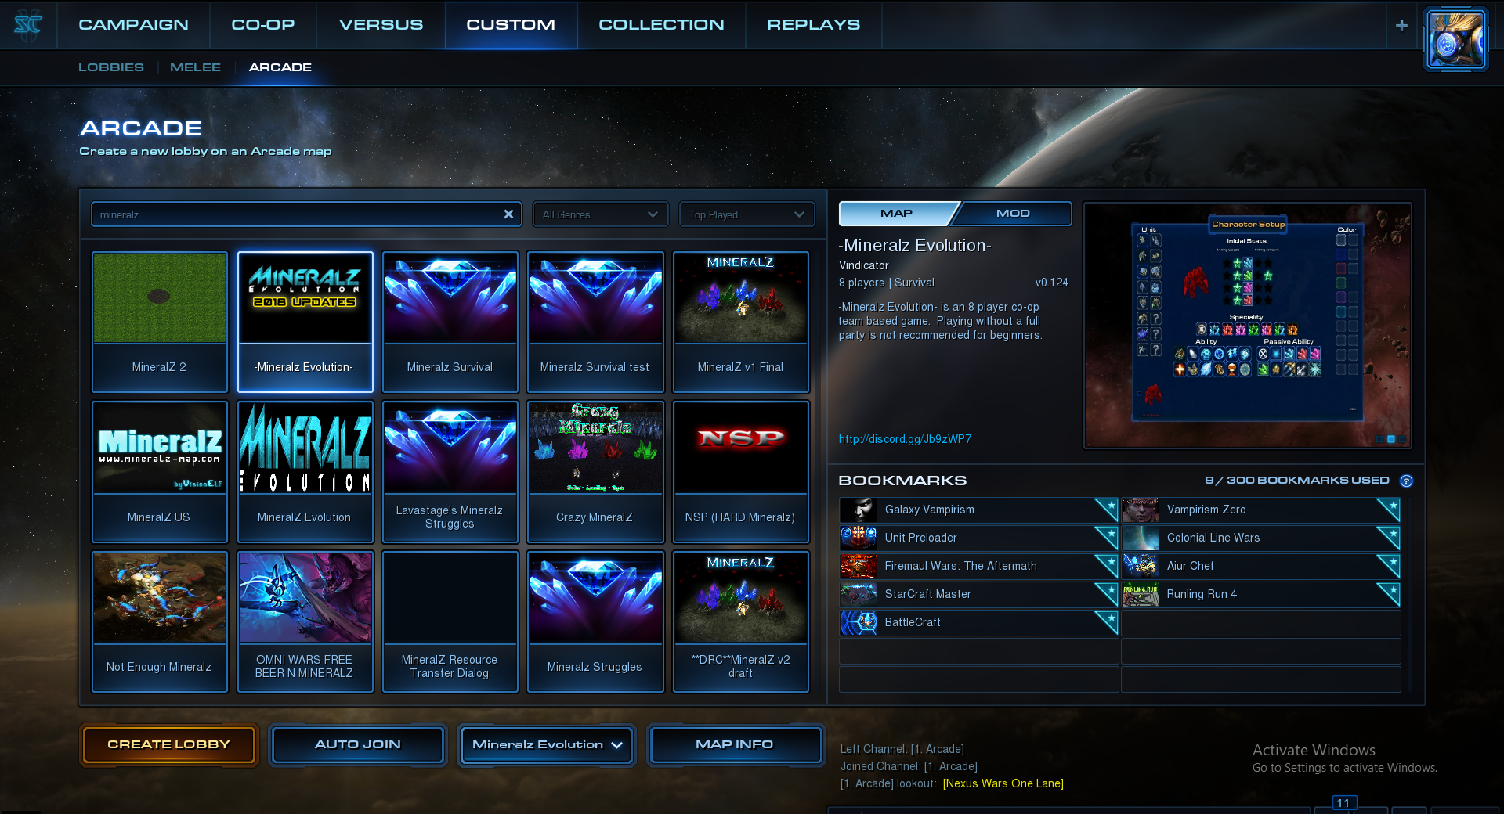

Slide 53
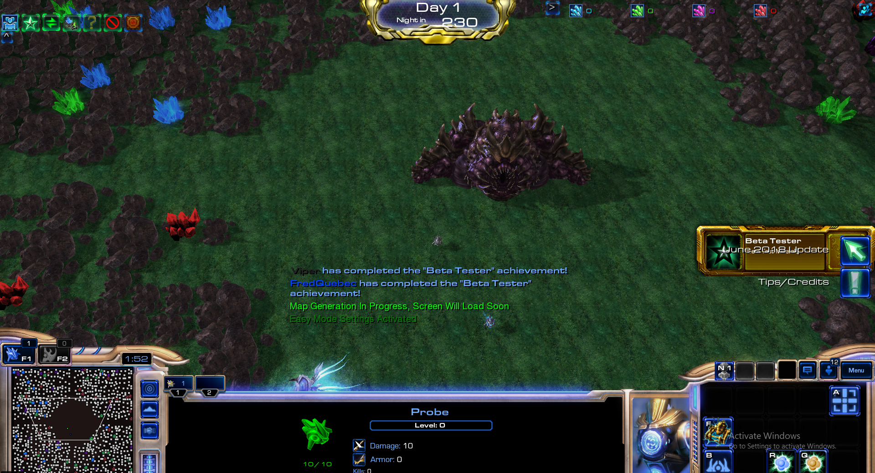

Slide 54

Resource Editing + Reverse Engineering
Exemple #3:
Custom Games - MineralZ
C:\Users\User\Documents\StarCraft II\Accounts\XXXXXX\X-XX-X-XXXXX\Banks\X-XX-X-XXXXXX\MapName.SC2Bank

Slide 55
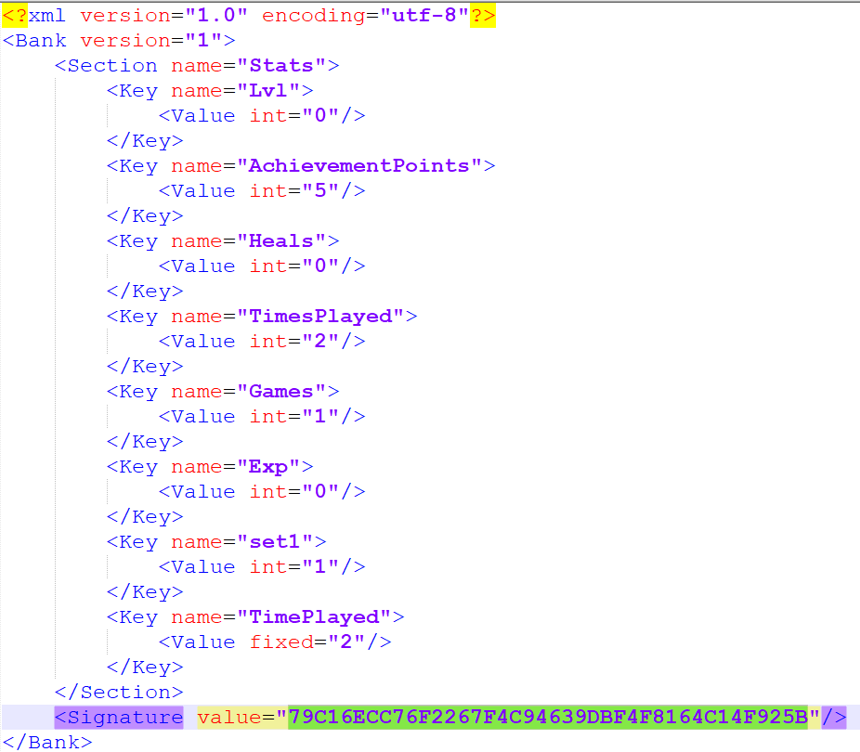

Slide 56
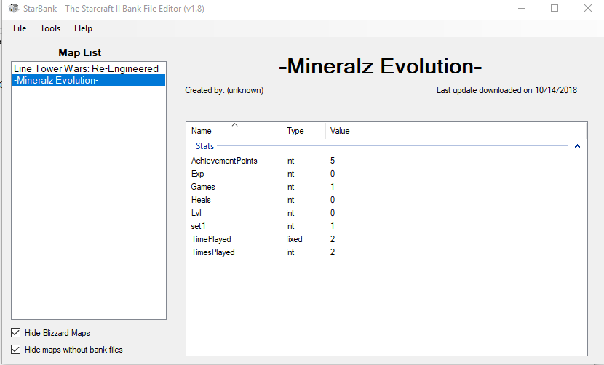

Slide 57
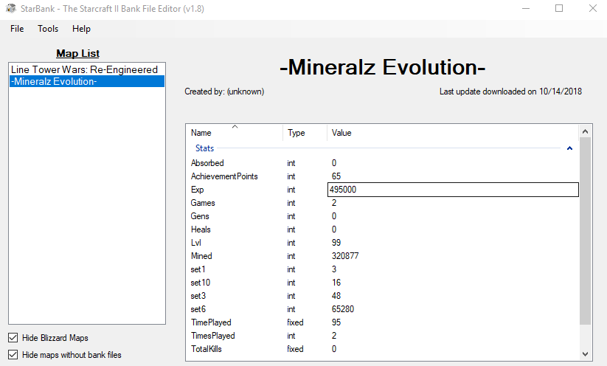

Slide 58
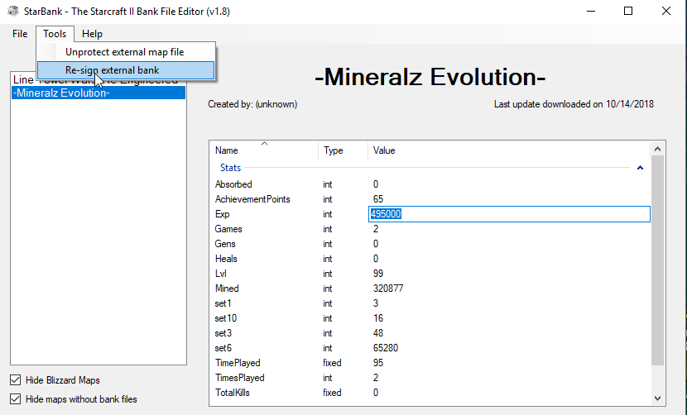

Slide 59
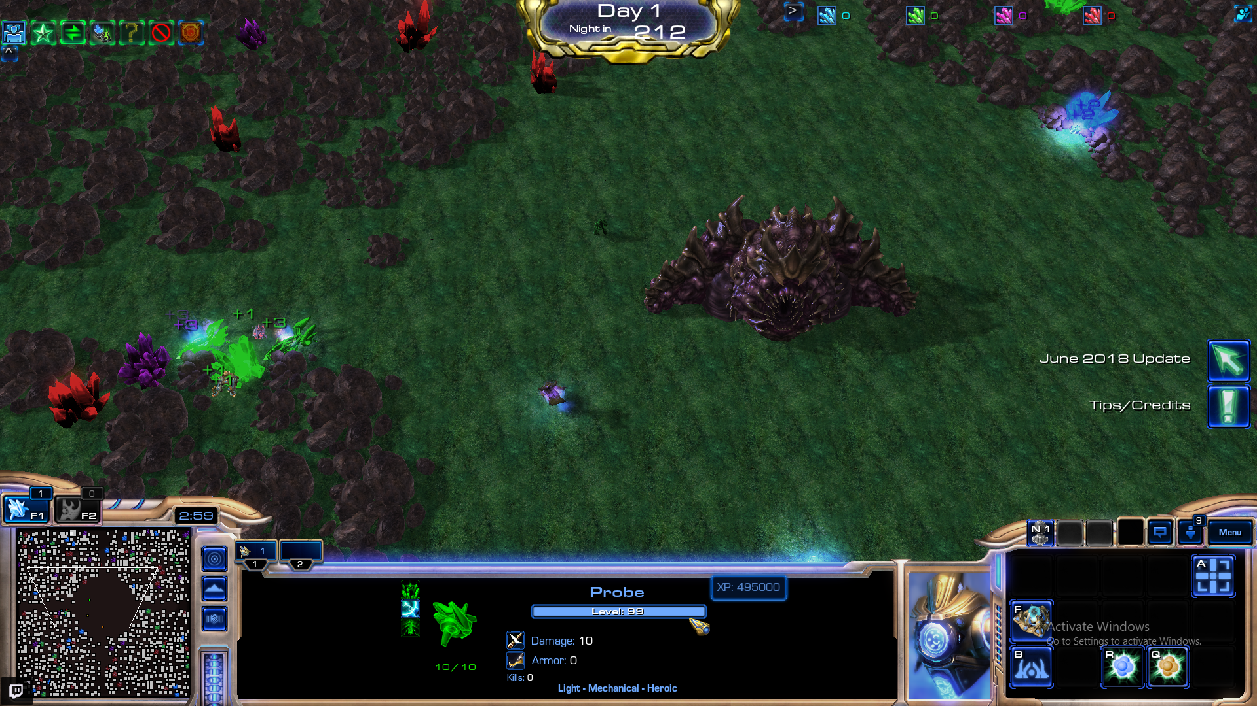

Slide 60
Resource Editing + Reverse Engineering
Exemple #3:
Without Tool
Starcraft Map Editor

Slide 61
Resource Editing + Reverse Engineering
Exemple #3:
Prevention:
Change algorithm
Implement encryption
Server side storage

Slide 62

Resource Editing + Reverse Engineering
Exemple #4:
Admin Console
` unlockConsole playsaurus4321
Save Edit
Tools:

Slide 63
Network Reverse Engineering
Pros:
Replay might be possible
Allow to automate really light bot
Packet manipulation
Tools:
Wireshark
Custom Tools

Slide 64
Network Reverse Engineering
Cons:
Hard to perform correctly
Takes time
A new patch can break your work
Prevention:
Encrypt network traffic
Certificate pinning
Behavior and logics verification

Slide 65

Network Reverse Engineering
Exemple #1:
WoW Custom Client
Tools: C++

Slide 66

Network Reverse Engineering
Exemple #2:
Pwn Adventure 3
Teleport
Tools: Wireshark + Python

Slide 67
DLL Injection
Pros:
Allow to call internal function
Interact with the game
Hook before network encryption
No need for mouse control
Tools:
C++

Slide 68
DLL Injection
Cons:
Relatively easily detectable
Prevention:
Anti-Cheat
Scan loaded DLL

Slide 69

DLL Injection
Bot Exemple:
https://www.youtube.com/watch?v=pCA_kcRXO4Y

Slide 70
Camera Hacks
Pros:
Access to more information about the game
Extend range projectiles
More reaction time
Tools:
Cheat Engine

Slide 71
Camera Hacks
Cons:
Detectable “easily”
Prevention:
Anti-Cheat
Scan loaded DLL

Slide 72
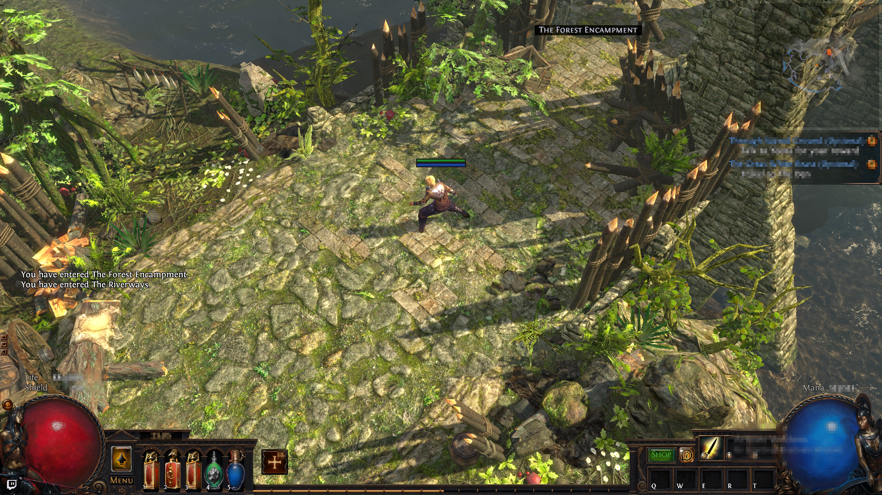

Slide 73
Camera Hacks
Exemple: Path Of Exile
https://youtu.be/txX7eX1tb2Y?t=16

Slide 74
What it took
Bought ~ 35 Diablo 2 CD Keys
10 Path Of Exile accounts banned
Lost some other Blizzard accounts

Slide 75
Upcoming ( Part 2)
Server Side Attacks
Game Engine Attacks

Slide 76
Special Thanks
GoSecure Team - For pushing me and giving me feedbacks
Hackfest Team - For motivating me and showing me that people want to know about game hacking
You guys for attending my first presentation!

Slide 77



Slide 78
Game Engine Attacks
Logic Flaws
Snapshots
Race Conditions

Slide 79
Logic Flaws
Pros:
Easy to exploit
Cons:
Sometimes hard to find
Lot of try and error
Tools:
Your brain
Patience
Understanding the game
Possible Hacks:
Unlimited Currency
Item Duping
Prevention:
Good Quality Assurance

Slide 80
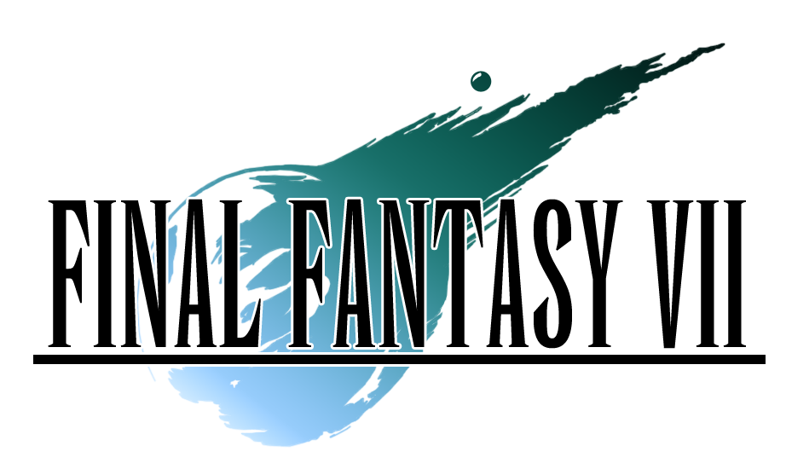
Logic Flaws
Trading W-Item Video
Hideout

Slide 81
Snapshots
Pros:
Break the Game (Power)
Cons:
Time consuming to perform the hack
Tools:
Game Knowledge
Possible Hacks:
Overpowered In Games Mechanics
Prevention:
Good Quality Assurance

Slide 82
Snapshots
Summoner Snapshotting

Slide 83
Race Conditions
Pros:
“Break the Game”
Cons:
Hard to time properly
Tools:
Advanced Game Knowledge
Possible Hacks:
Item Dupes
Speed Hacks
Prevention:
Good Quality Assurance

Slide 84


Race Conditions
Duping Diablo Speed Hack SM64

Slide 85
Server Side Attacks
Denial of Service Attacks
Lag Hacks
Economy Control
Social Engineering

Slide 86
Denial of Service Attacks
Pros:
Easy to do
Cons:
Easily Detectable
Bannable
Tools:
Game Knowledge
Possible Hacks:
Item Dupes
Rollback
Prevention:
Server Crash Logs

Slide 87

Denial of Service Attacks
Necromancer Instance Crash

Slide 88
Lag Hacks
Pros:
Open Chest / Loot
Cons:
Troublesome to execute
Tools:
RJ45 Cable
Lag Switch
Possible Hacks:
Open Chest without meeting requirement
Prevention:
Remove Chest / Loot in instance
Lockstep

Slide 89

Lag Hacks
WoW Chest Dungeon

Slide 90
Economy Control
Pros:
Make LOTS of money
Emulate Economy Safely
Cons:
Require advanced in game knowledge
Risk
Tools:
Advanced Game Knowledge
Possible Hacks:
“Infinite Gold”
Prevention:
Hard Cap at market price

Slide 91
Economy Control
Market Analysis
Scarcity

Slide 92
Social Engineering
Pros:
No Limits!
Cons:
Require Time
Require Human Interaction
Tools:
Chat (Player Interaction)
Possible Hacks:
Code Execution
Trading
Prevention:
Educate People
Remove Trading?

Slide 93
Social Engineering
Code Execution

Slide 94
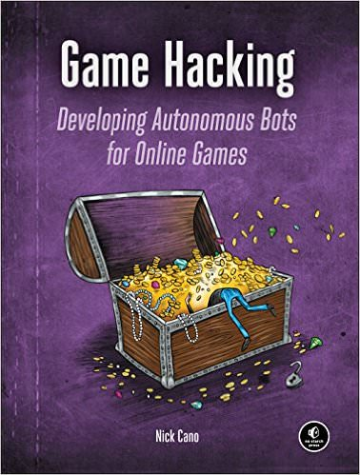
Where to Start?
http://www.pwnadventure.com/

Slide 95
References
SmashBot - https://www.youtube.com/watch?v=_0Z_oN_CZyA
http://www.pwnadventure.com/
https://en.wikipedia.org/wiki/Cheating_in_online_games

